Slide 1
Deep Reinforcement Learning with Double Q-learning
Hado van Hasselt and Arthur Guez and David Silver
Notes:
Made by Andrew Michelmore and Na Ma

Slide 2
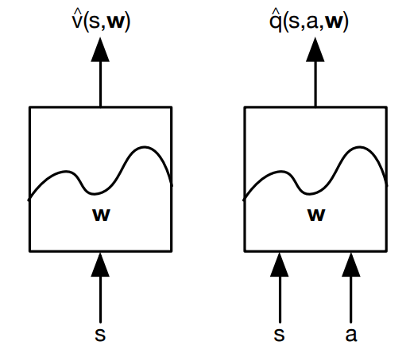
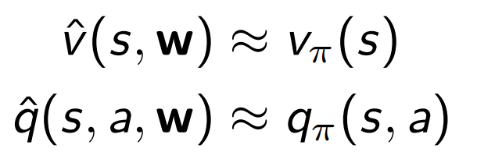
Function Approximation
Weighted linear combination of features

Slide 3
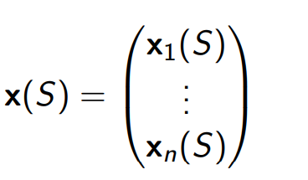
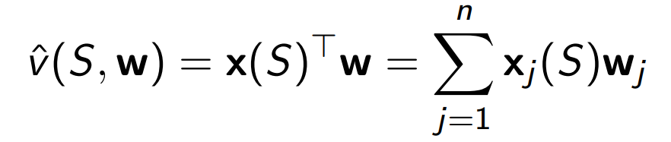
Features
Feature vector
Distance from points of interest
Word count in spam filter
Linear value function approximation

Slide 4
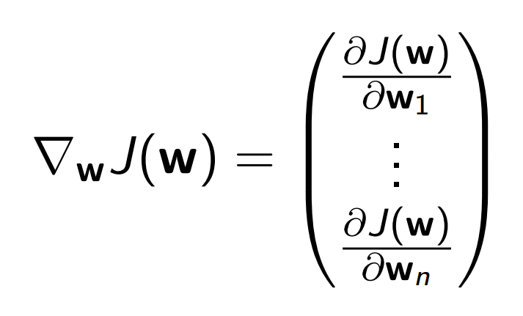
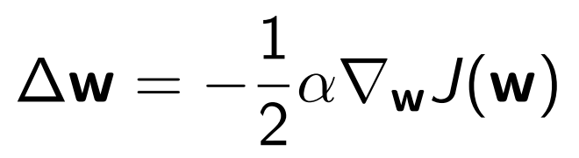
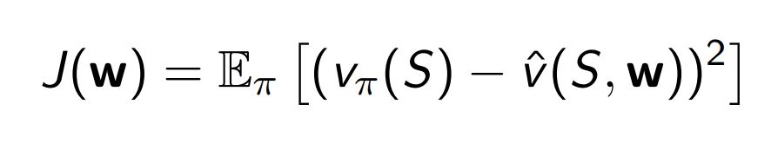
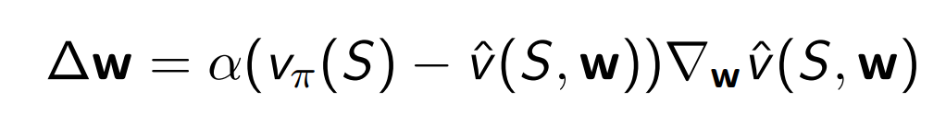
Stochastic Gradient Descent
Update the weights in the direction of the gradient
Value function update

Slide 5
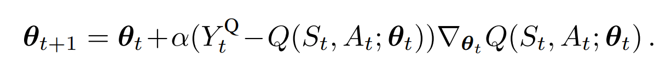
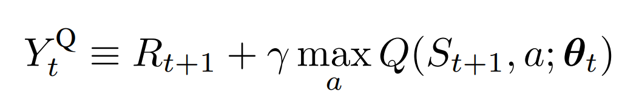
Q-learning
Standard Q-learning update

Slide 6
Double Q-Learning
Use two action-values estimates
Update each with equal probability

Slide 7
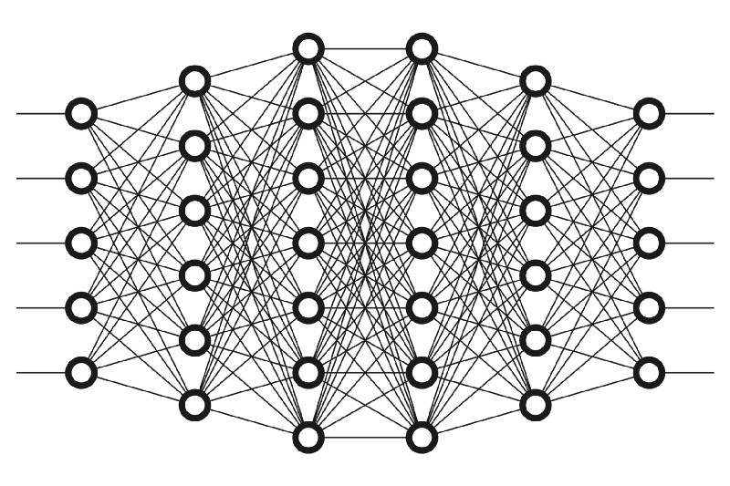
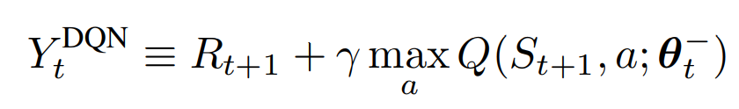
Deep Q Networks
Neural net using frames as input
Need to use batch methods due to number of weights that need to be trained.
Θ⁻ is the target network
Θ is the online network
Update Θ⁻ from Θ
Every τ steps Θ_{t}⁻ = Θ_{t}
(same as normal Q-Learning)

Slide 8
Double Deep Q-Networks
Bootstrap from the target network Θ⁻
To Update Θ for Q(S_{t},A_{t},Θ)
Take action A_{t} and observe reward R_{t+1}
Select next action A_{t+1} based on Θ_{t}
Bootstrap from Q(S_{t+1},A_{t+1},Θ⁻)
This does not take much more computational power because you are not creating more weight matrices to do double learning.

Slide 9

Overoptimism due to estimation errors
Due to Q-Learning bootstrapping to the maximum next action value it can overestimate the value function.
If random errors are contained within the interval [−Є ,Є], The value function will be overestimated up to: (where m is the # of actions)

Slide 10


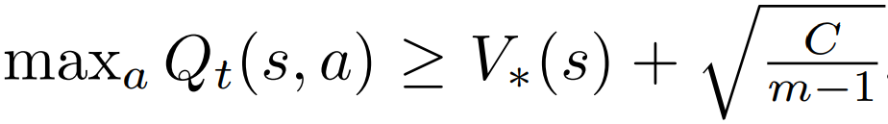
Theorem 1
We are in a state where the optimal action values are all equal. However the current action values are not all equal
(Though they are unbiased such that)
Under these conditions the bootstrap overestimate has a lower bound of

Slide 11
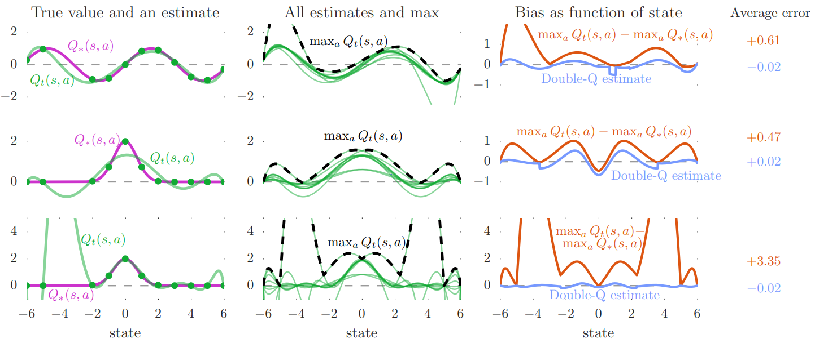
Q-Learning and Function Approximation Errors
If you are lacking data in some areas of the state space Q-Learning is likely to overestimate these areas

Slide 12
Empirical results
Analyze the overestimations of DQN and show that Double DQN improves over DQN both in terms of value accuracy and in terms of policy quality
To test the robustness of the approach, additionally evaluate the algorithms with random starts generated from expert human trajectories.

Slide 13
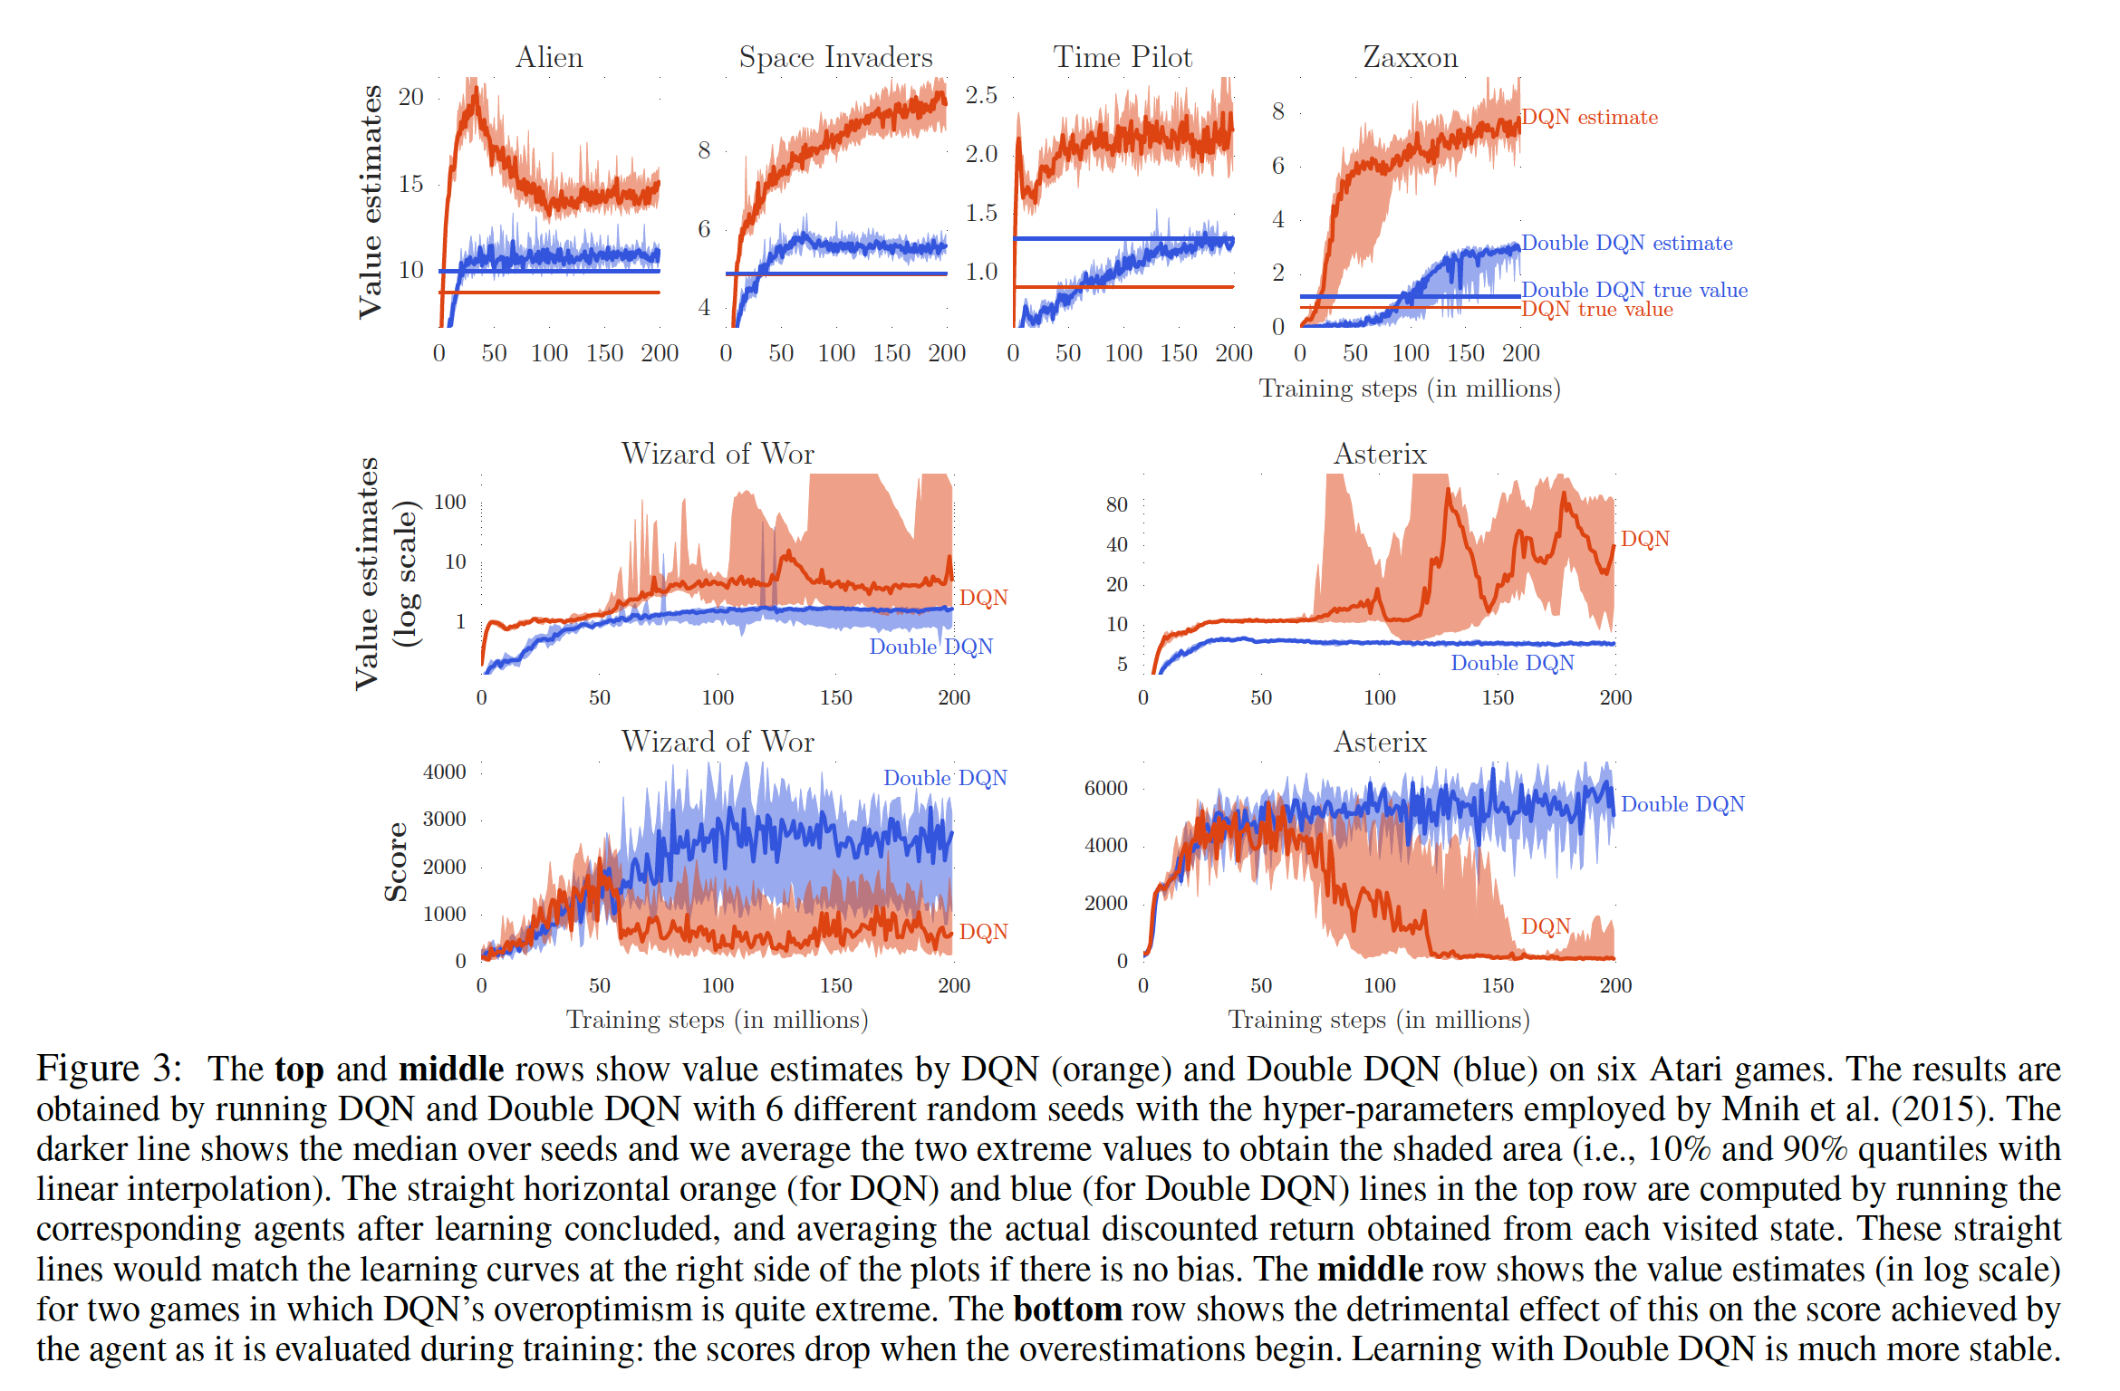
Results on overoptimism
Notes:
DQN is consistently and sometimes vastly overoptimistic about the value of the current greedy policy
Note that the blue straight line is often higher than the orange straight line. This indicates that Double DQN does not just produce more accurate value estimates but also better policies.
Notice that the increases in value estimates for DQN in the middle plots coincide with decreasing scores in bottom plots. this indicates that the overestimations are harming the quality of the resulting policies.
If seen in isolation, one might perhaps be tempted to think the observed instability is related to inherent instability problems of off-policy learning with function approximation, However, we see that learning is much more stable with Double DQN, suggesting that the cause for these instabilities is in fact Q learning’s overoptimism.

Slide 14

Quality of the learned policies
Overoptimism does not always adversely affect the quality of the learned policy. Nevertheless, reducing overestimations can significantly benefit the stability of learning.
Assess more generally how much Double DQN helps in terms of policy quality by evaluating on all 49 games.
Each evaluation episode starts by executing a special no-op action that does not affect the environment up to 30 times, to provide different starting points for the agent.
Double DQN used the exact same hyper-parameters as for DQN, to allow for a controlled experiment focused just on reducing overestimations.
The scores are averaged over 100 episodes.

Slide 15
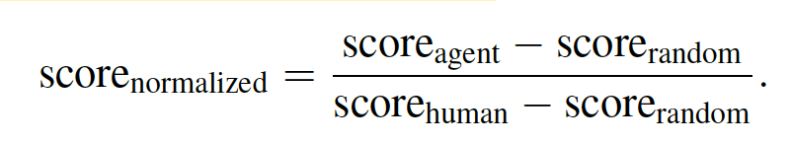
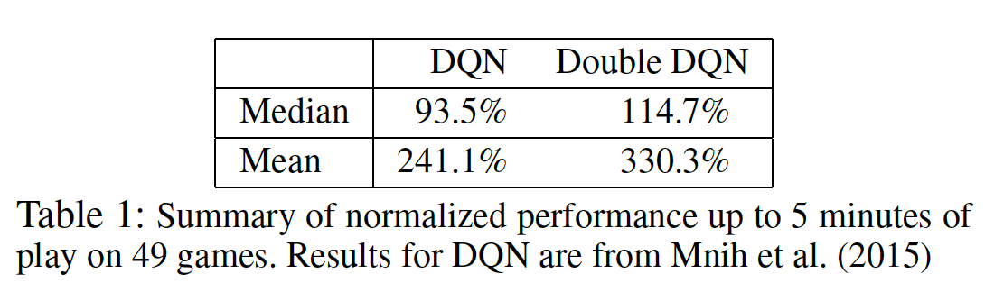
Quality of the learned policies
To obtain summary statistics across games, we normalize the score for each game as follows:

Slide 16
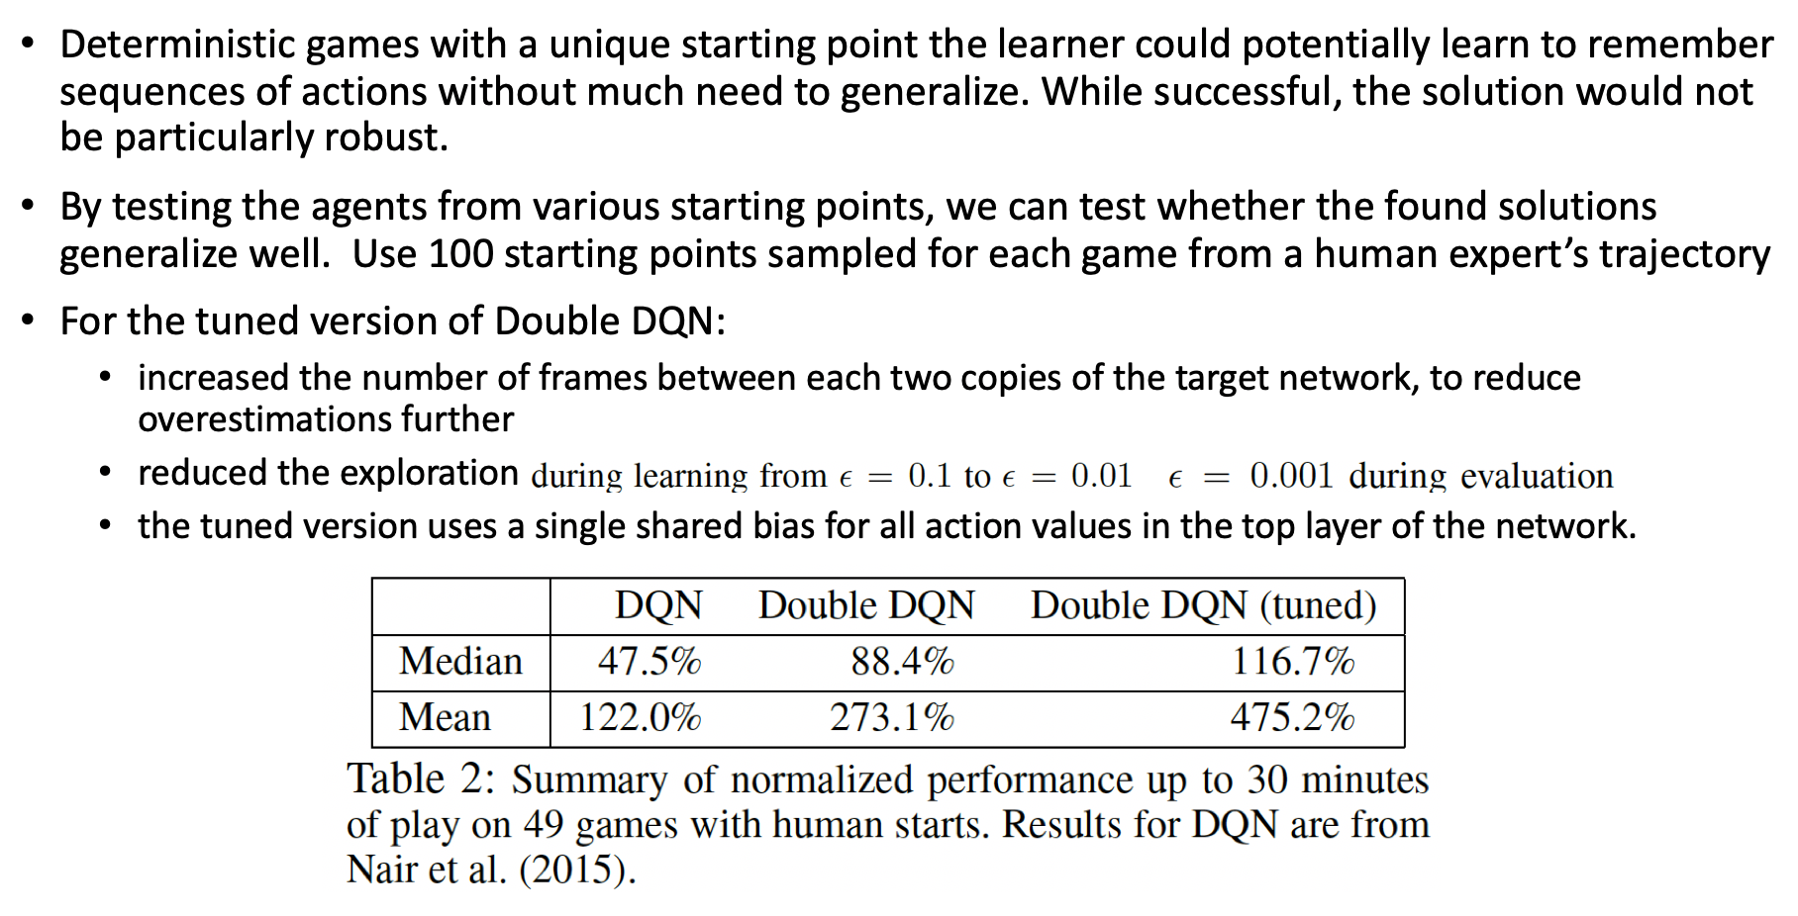
Robustness to Human starts

Slide 17
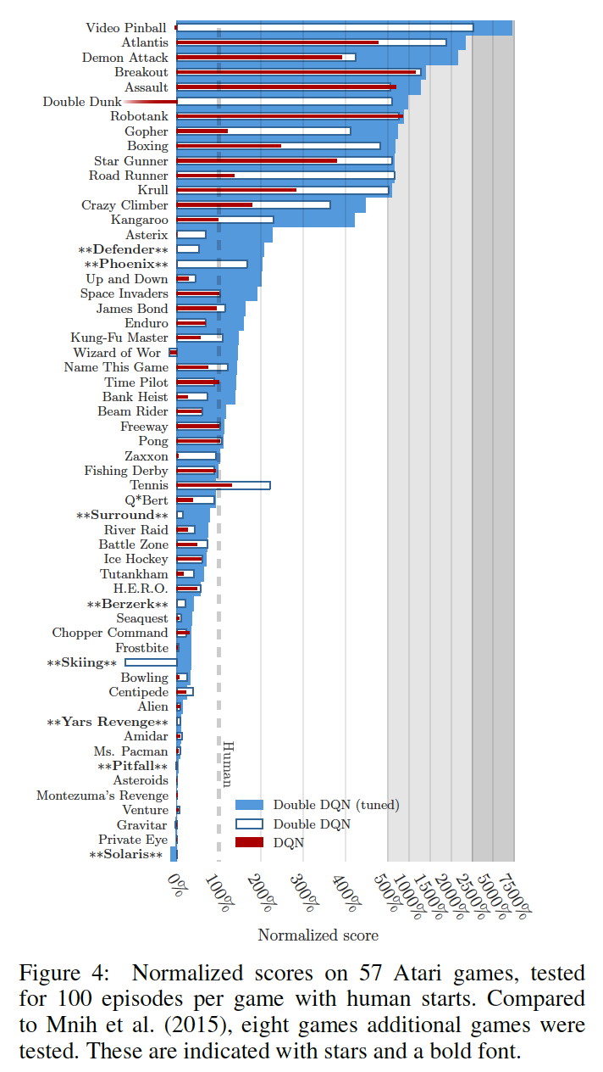
Robustness to Human starts
On several games the improvements from DQN to Double DQN are striking, in some cases bringing scores much closer to human, or even surpassing these.
Double DQN appears more robust to this more challenging evaluation, suggesting that appropriate generalizations occur and that the found solutions do not exploit the determinism of the environments.
This is appealing, as it indicates progress towards finding general solutions rather than a deterministic sequence of steps that would be less robust.

Slide 18
Discussion
Shown why Q-learning can be overoptimistic in large-scale problems, due to the inherent estimation errors of learning.
Analyzed the value estimates on Atari games we have shown that these overestimations are more common and severe in practice than previously acknowledged.
Shown that Double Q-learning can be used at scale to successfully reduce overoptimism, resulting in more stable and reliable learning.
Proposed Double DQN, that uses the existing architecture and deep neural network of the DQN algorithm without requiring additional networks or parameters.
Shown that Double DQN finds better policies.

Slide 19
Refrences
https://arxiv.org/abs/1509.06461
http://www0.cs.ucl.ac.uk/staff/d.silver/web/Teaching_files/FA.pdf
https://www.freecodecamp.org/news/want-to-know-how-deep-learning-works-heres-a-quick-guide-for-everyone-1aedeca88076/

